Slide 1
Section – III:
TRANSFORMATIONS
in 2-D

Slide 2
Representation of Points:
2D TRANSFORMATIONS AND MATRICES
2 x 1 matrix:
⎡ X ⎤
⎢_{Y} ⎥
⎣ ⎦
General Problem: [B] = [T] [A]
[T] represents a generic operator to be applied to the points in A. T is the geometric transformation matrix.
If A & T are known, the transformed points are obtained by calculating B.

Slide 3
General Transformation of 2D points:
⎡a
⎡ x'⎤ c ⎤ ⎡ x⎤
⎡ x'⎤^{T} ⎡ x⎤^{T} ⎡a
b⎤
⎢ _{y'}⎥ ⁼ ⎢_{b d} ⎥ ⎢ _{y}⎥
⎢ _{y'}⎥ ⁼ ⎢ _{y}⎥ ⎢_{c d} ⎥
⎣ ⎦ ⎣ ⎦ ⎣ ⎦
⎣ ⎦ ⎣ ⎦ ⎣ ⎦
x' = ax + cy y' = bx + dy
x' = ax + cy y' = bx + dy
Solid body transformations – the above equation is valid for all set of points and lines of the object being transformed.

Slide 4
Special cases of 2D Transformations:
T = identity matrix:
a=d=1, b=c=0 => x'=x, y'=y
Scaling & Reflections:
b=0, c=0 => x' = a.x, y' = d.y; This is scaling by a in x, d in y.
If, a = d > 1, we have enlargement;
If, 0 < a = d < 1, we have compression;
If a = d, we have uniform scaling,
⎡S_{x} 0 ⎤
⎢
_{⎣ 0} ⎥
else non-uniform scaling.
Scale matrix: let S
= a, S = d:
S_{y ⎦}
x
y

Slide 5
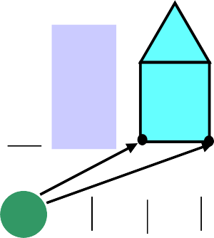
Example of Scaling
Y 6
5
4
3
2
1
⎡9 ⎤
S = 3
⎡2⎤
⎡3⎤
⎢₂ ⎥
x
S_{y} = 2
⎣ ⎦
⎢₁⎥
⎢ ⎥
⎣ ⎦
⎣¹⎦
⎡ 6 ⎤
⎢ ₂ ⎥
⎣ ⎦
0
X
1 2 3 4 5 6 7 8 9
What if S_{x} and/ or S_{y} < 0 (are negative)? Get reflections through an axis or plane.
Only diagonal terms are involved in scaling and reflections.
Note : House shifts position relative to origin

Slide 6
More examples of Scaling and reflection
Reflection (about the Y-axis)
x´= – x
x
Non-uniform scaling
θ
x
x´= x + ay

Slide 7
Special cases of Reflections (|T| = -1)
Matrix T |  |  |  |  |  |  |  |  |  | Reflection about
 | ⎡1 0 ⎤ ⎢0 − 1⎥ ⎣ ⎦ |  |  |  |  |  |  |  |  | Y=0 Axis (or X-axis)
 |  |  |  | ⎡− 1 0⎤ ⎢ ₀ ₁⎥ ⎣ ⎦ |  |  |  |  |  | X=0 Axis (or Y-axis)
 |  | ⎡ 0 ⎢ ₁ ⎣ | 1 ⎤ ₀ ⎥ ⎦ |  |  |  |  |  |  | Y = X | Axis
 |  |  | ⎡ 0 ⎢− 1 ⎣ |  |  |  | − 1⎤ ₀ ⎥ ⎦ |  |  | Y = -X | Axis

Slide 8
Off diagonal terms are involved
in SHEARING;
⎡a
c ⎤ ⎡ x⎤ ₌ ⎡ x'⎤
a = d = 1;
⎢_{b d} ⎥ ⎢ _{y}⎥ ⎢ _{y'}⎥
⎣ ⎦ ⎣ ⎦ ⎣ ⎦
let, c = 0, b = 2
x'= ax + cy y'= bx + dy
x' = x
y' = 2x + y ;
y' depends linearly on x ; This effect is called shear.
Similarly for b=0, c not equal to zero. The shear in this case is proportional to y-coordinate.

Slide 9
X'= xcos (θ )− ysin (θ)
ROTATION
Y
5
4
3
2
1
0
θ = 30°
Y'= xsin (θ)+ ycos (θ)
In matrix form, this is :
_{T =} ⎡cos(θ ) - sin(θ )⎤
θ
⎢sin(θ ) cos(θ ) ⎥
⎣ ⎦
1
2
3 5
X
4
Positive Rotations: counter clockwise about the origin
For rotations, |T| = 1 and [T]^{T} = [T]⁻¹. Rotation matrices are orthogonal.

Slide 10
θ (in degrees)
Special cases of Rotations
Matrix T
90
⎡ 0 1⎤
₀⎥
⎢− 1
⎣
⎦
⎡− 1 0 ⎤
180
⎢ ₀
⎣
⎡ 0 1 ⎤
− 1⎥
⎦
270 or -90
₀ ⎥
⎢− 1
⎣
⎦
360 or 0
⎡1 0 ⎤
⎢ ₀ ₁ ⎥
⎣
⎦

Slide 11
Example - Transformation of a Unit Square
Y
b+d
d
Y
(1, 1)
b
x
x
c
a
a+c
⎡0 0⎤
⎢1 0⎥
⎡
0
a
0
b
⎤
⎥
⎢
S = ⎢
⎥
⎢1 1⎥
⎢0 1⎥
⎡a b ⎤
S ' = S ⎢
_{⎥ =} ⎢
⎥
⎣ c d ⎦
⎢a + c
b + d ⎥
⎢
⎥
⎣ ⎦
⎣
c d
⎦
Area of the unit square after transformation
= ad - bc = |T|.
Extend this idea for any arbitrary area.

Slide 12
Translations
Y
6
5
4
3
2
1
0
t_{x} = 5
⎡2⎤
t = 1
⎢₂⎥
y
⎣ ⎦
⎡ 7 ⎤
⎢ ₃ ⎥
⎣ ⎦
X
1 2 3 4 5 6 7 8 9

Slide 13
Translations
B = A + T_{d} , where T_{d} = [t_{x} t_{y}]^{T}
Where else are translations introduced?
Rotations - when objects are not centered at the origin.
Scaling - when objects/lines are not centered at the origin - if line intersects the origin, no translation.
Origin is invariant to Scaling, reflection and Shear – not translation.

Slide 14
Note: we cannot directly represent translations as matrix multiplication, as we can for:
SCALING
ROTATION
Can we represent translations in our general transformation matrix?
Yes, by using homogeneous coordinates

Slide 15
HOMOGENEOUS COORDINATES
⎡a c
⎢ y'⎥ = ⎢b d
0
⎡ x'⎤
t_{x} ⎤ ⎡x⎤
Use a 3 x 3 matrix:
_{t} ⎥*⎢ _{y}⎥
⎢ ⎥ ⎢
⎢⎣w'⎥⎦ ⎢⎣0
^{y} ⎥ ⎢ ⎥
1⎥⎦ ⎢⎣w⎥⎦
We have:
x' = ax + cy + t_{x} y' = bx + cy + t_{y}
Each point is now represented by a triplet: (x, y, w).
(x/w, y/w) are called the Cartesian coordinates of the homogeneous points.

Slide 16
Interpretation of Homogeneous Coordinates
W
P_{h} (x, y, w)
1
P_{2d}(x/w, y/w, 1)
x
Y

Slide 17
Two homogeneous coordinates (x₁, y₁, w₁) & (x₂, y₂, w₂) may represent the same point,
iff they are multiples of one another: say, (1,2,3) & (3,6,9).
There is no unique homogeneous representation of a point.
All triples of the form (t.x, t.y, t.W) form a line in x,y,W space.
Cartesian coordinates are just the plane w=1 in this space.
W=0, are the points at infinity

Slide 18
⎡ a b p ⎤
T = ⎢ c d n
General Purpose 2D transformations in homogeneous coordinate representation
_{q} ⎥
⎢
⎢⎣ m
⎥
s ⎥⎦
Parameters involved in scaling, rotation, reflection and shear are: a, b, c, d
If B = T.A, then
If B = A.T, then
Translation parameters: (p, q)
Translation parameters: (m, n)
What about
S ?

Slide 19
COMPOSITE TRANSFORMATIONS
If we want to apply a series of transformations T₁, T₂, T₃ to a set of points, We can do it in two ways:
We can calculate p'=T₁*p, p''= T₂*p', p'''=T₃*p''
Calculate T= T₁*T₂*T₃, then p'''= T*p.
Method 2, saves large number of additions and multiplications (computational time) – needs approximately 1/3 of as many operations. Therefore, we concatenate or compose the matrices into one final transformation matrix, and then apply that to the points.

Slide 20
⎡1 0 (tx₁ + tx₂ )⎤ 1
Translations:
Translate the points by tx₁, ty₁, then by tx₂, ty₂:
⎢₀
(ty + ty )⎥
⎢
⎢⎣0
1 2
⎥
⎥⎦
0
1
Scaling:
Similar to translations
Rotations:
Rotate by θ₁, then by θ₂:
stick the (θ₁+ θ₂) in for θ, or
calculate T₁ for θ₁, then T₂ for θ₂ & multiply them.
Exercise: Both gives the same result – work it out

Slide 21
Rotation about an arbitrary point P in space
As we mentioned before, rotations are applied about the origin. So to rotate about any arbitrary point P in space, translate so that P coincides with the origin, then rotate, then translate back. Steps are:
Translate by (-P_{x}, -P_{y})
Rotate
Translate by (P_{x}, P_{y})

Slide 22





Rotation about an arbitrary
point P in space
P₁
θ
House at P₁
Rotation by θ
P₁
Translation of P₁ to Origin
Translation back to P₁

Slide 23
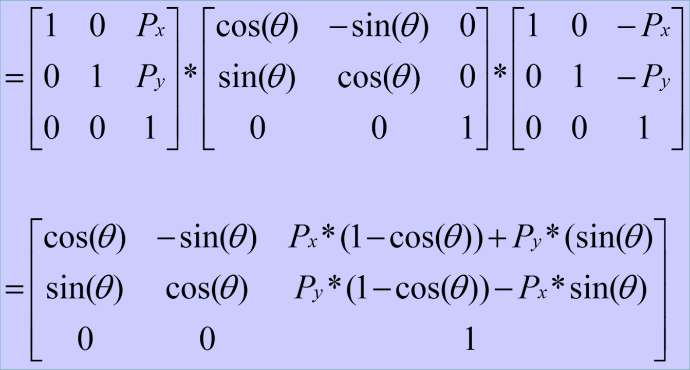
Rotation about an arbitrary point P in space
T = T₃(P_{x}, P_{y}) * T₂(θ) * T₁(-P_{x}, -P_{y})

Slide 24
Scaling about an arbitrary point in Space
Again,
Translate P to the origin
Scale
Translate P back
T = T₁(P_{x}, P_{y})* T₂(S_{x}, S_{y})*T₃(-P_{x}, -P_{y})
⎡ Sx
0 {Px *(1− Sx)}⎤
Sy
0
T = ⎢ 0
{Py *(1− Sy)}⎥
⎢ ₀
⎥
⎣
1
⎦

Slide 25
Reflection through an arbitrary line
Steps:
Translate line to the origin
Rotation about the origin
Reflection matrix
Reverse the rotation
Translate line back
_{R}T _{T} −1
^{T}GenRfl ^{= T}r ^{R T}rfl
r

Slide 26

Commutivity of Transformations
If we scale, then translate to the origin, and then translate back, is that equivalent to translate to origin, scale, translate back?
When is the order of matrix multiplication unimportant?
When does T₁ * T₂ = T₂ * T₁?
Cases where T₁ * T₂ = T₂ * T₁:
T₁ | T₂
translation | translation
scale | scale
rotation | rotation
scale(uniform) | rotation

Slide 27
Order: R-G-B
Scale, translate
Translate, scale
Rotate, differential scale
Differential scale, rotate

Slide 28
COORDINATE SYSTEMS
Screen Coordinates: The coordinate system used to address the screen (device coordinates)
World Coordinates: A user-defined application specific coordinate system having its own units of measure, axis, origin, etc.
Window: The rectangular region of the world that is visible.
Viewport: The rectangular region of the screen space that is used to display the window.

Slide 29
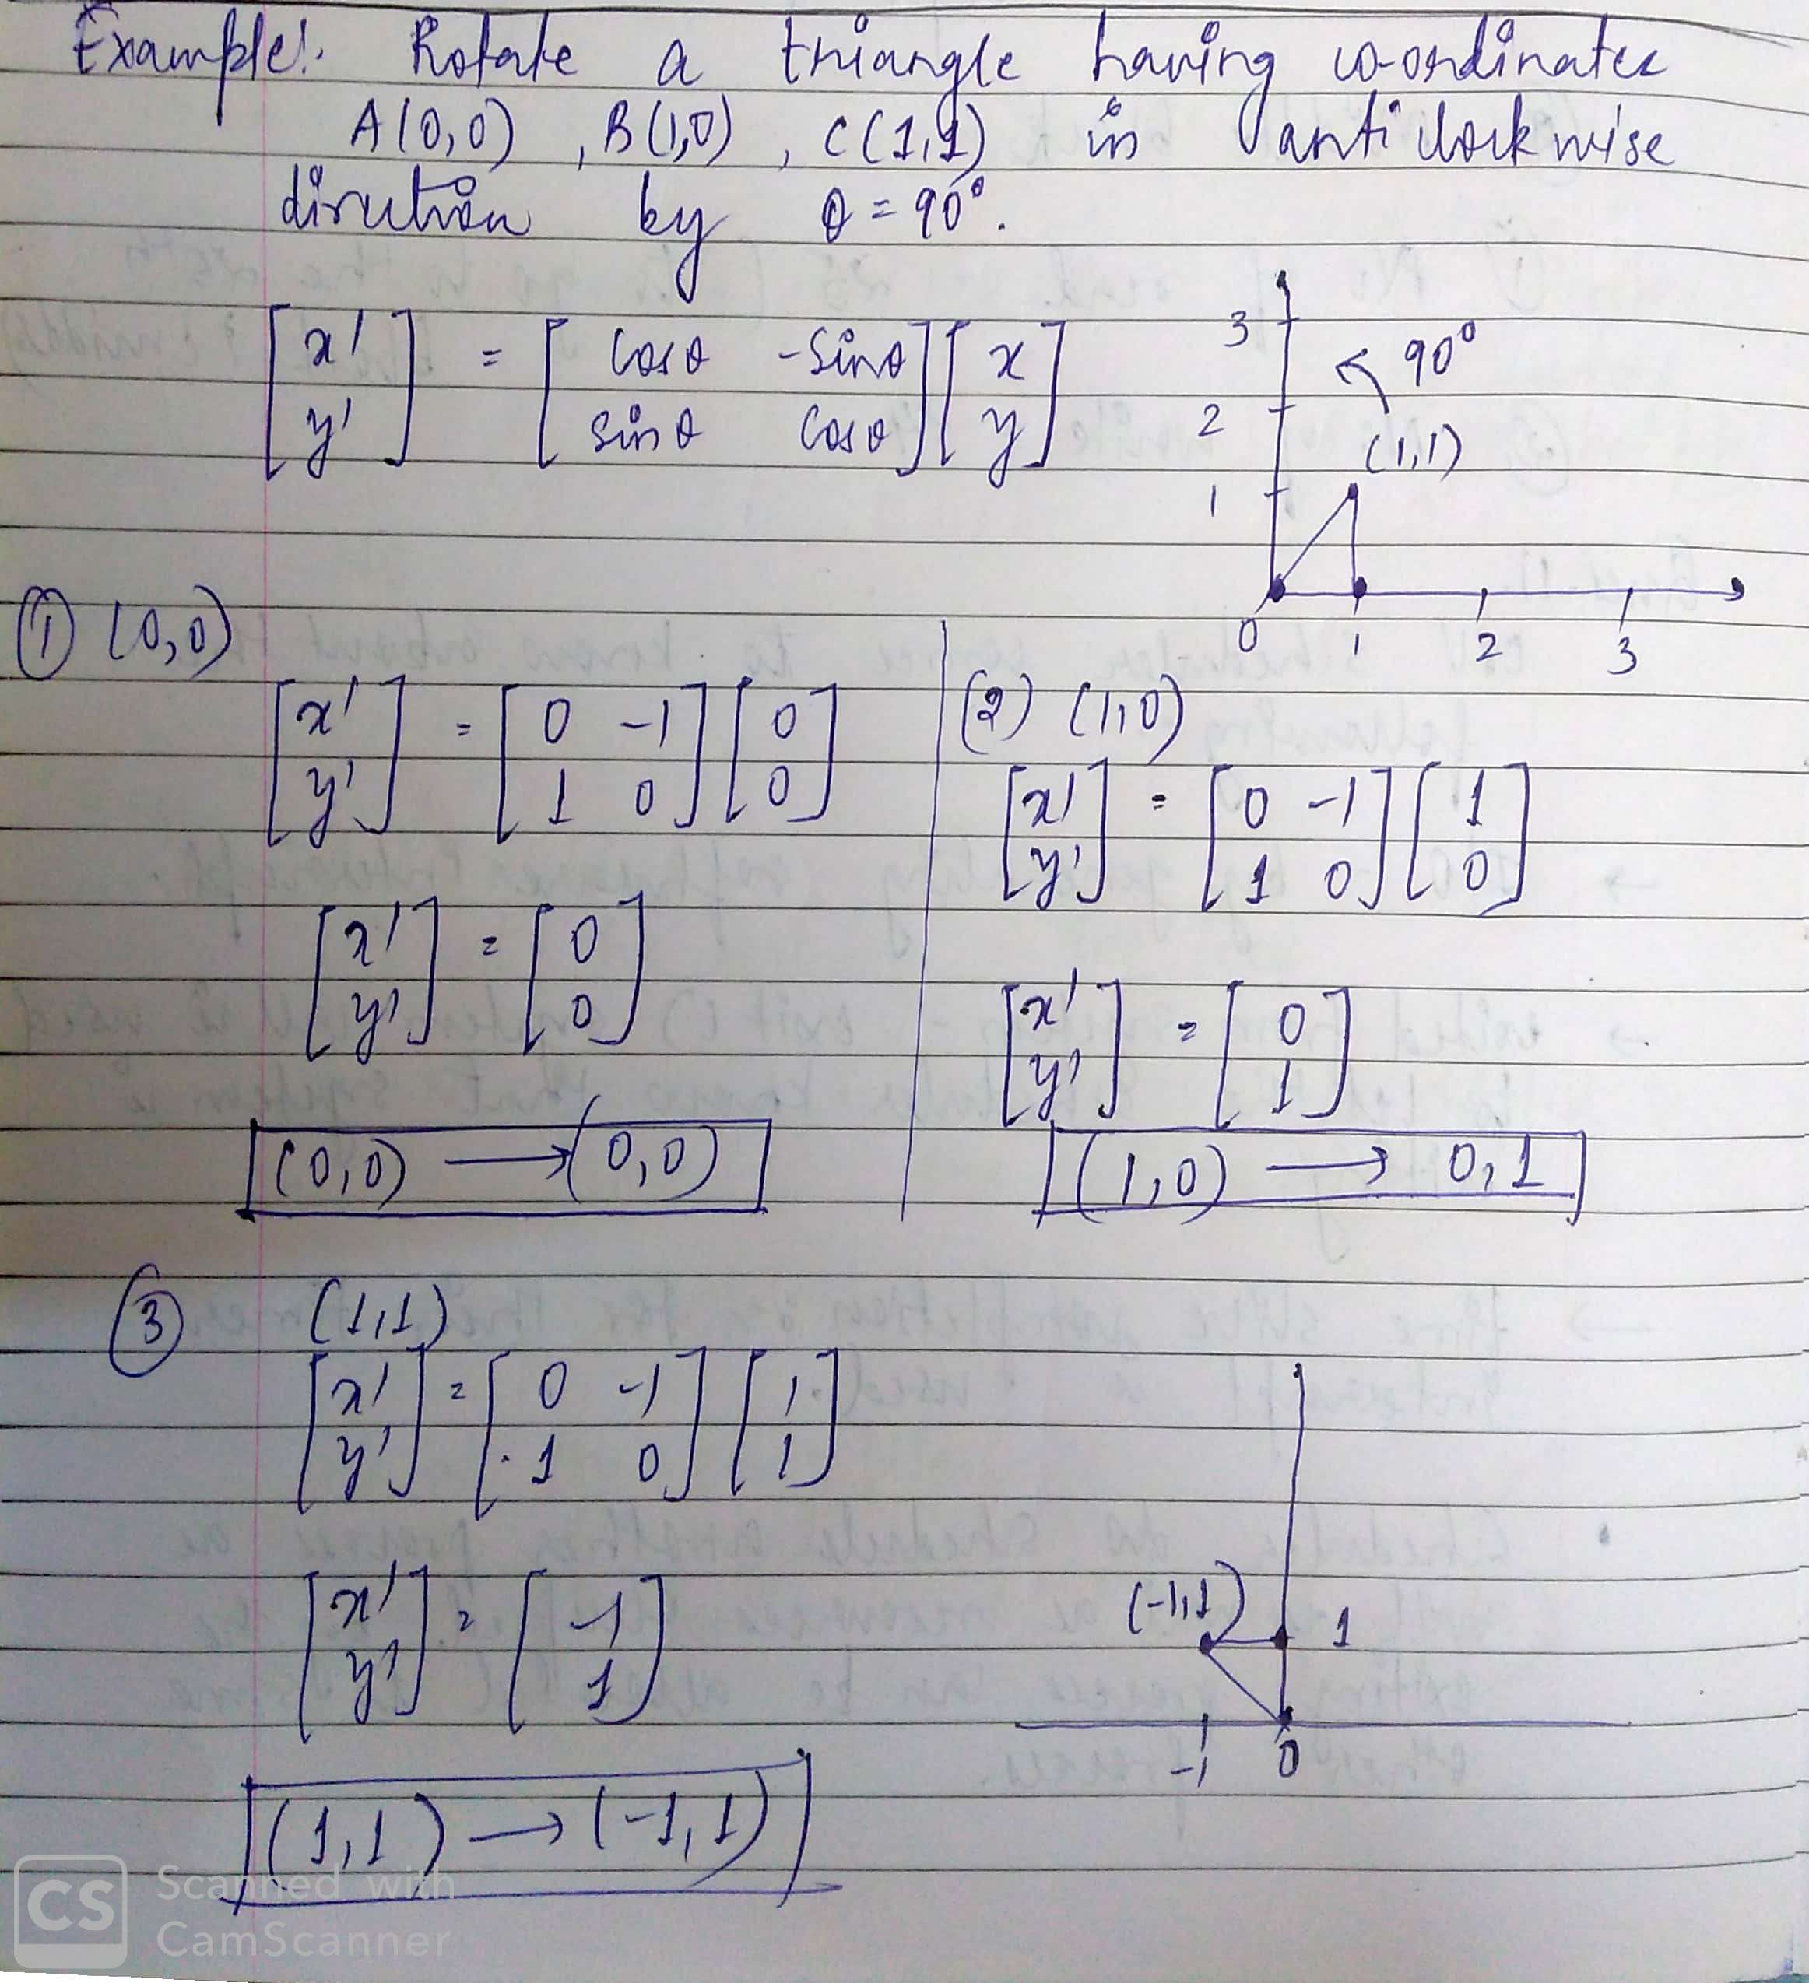

Slide 30
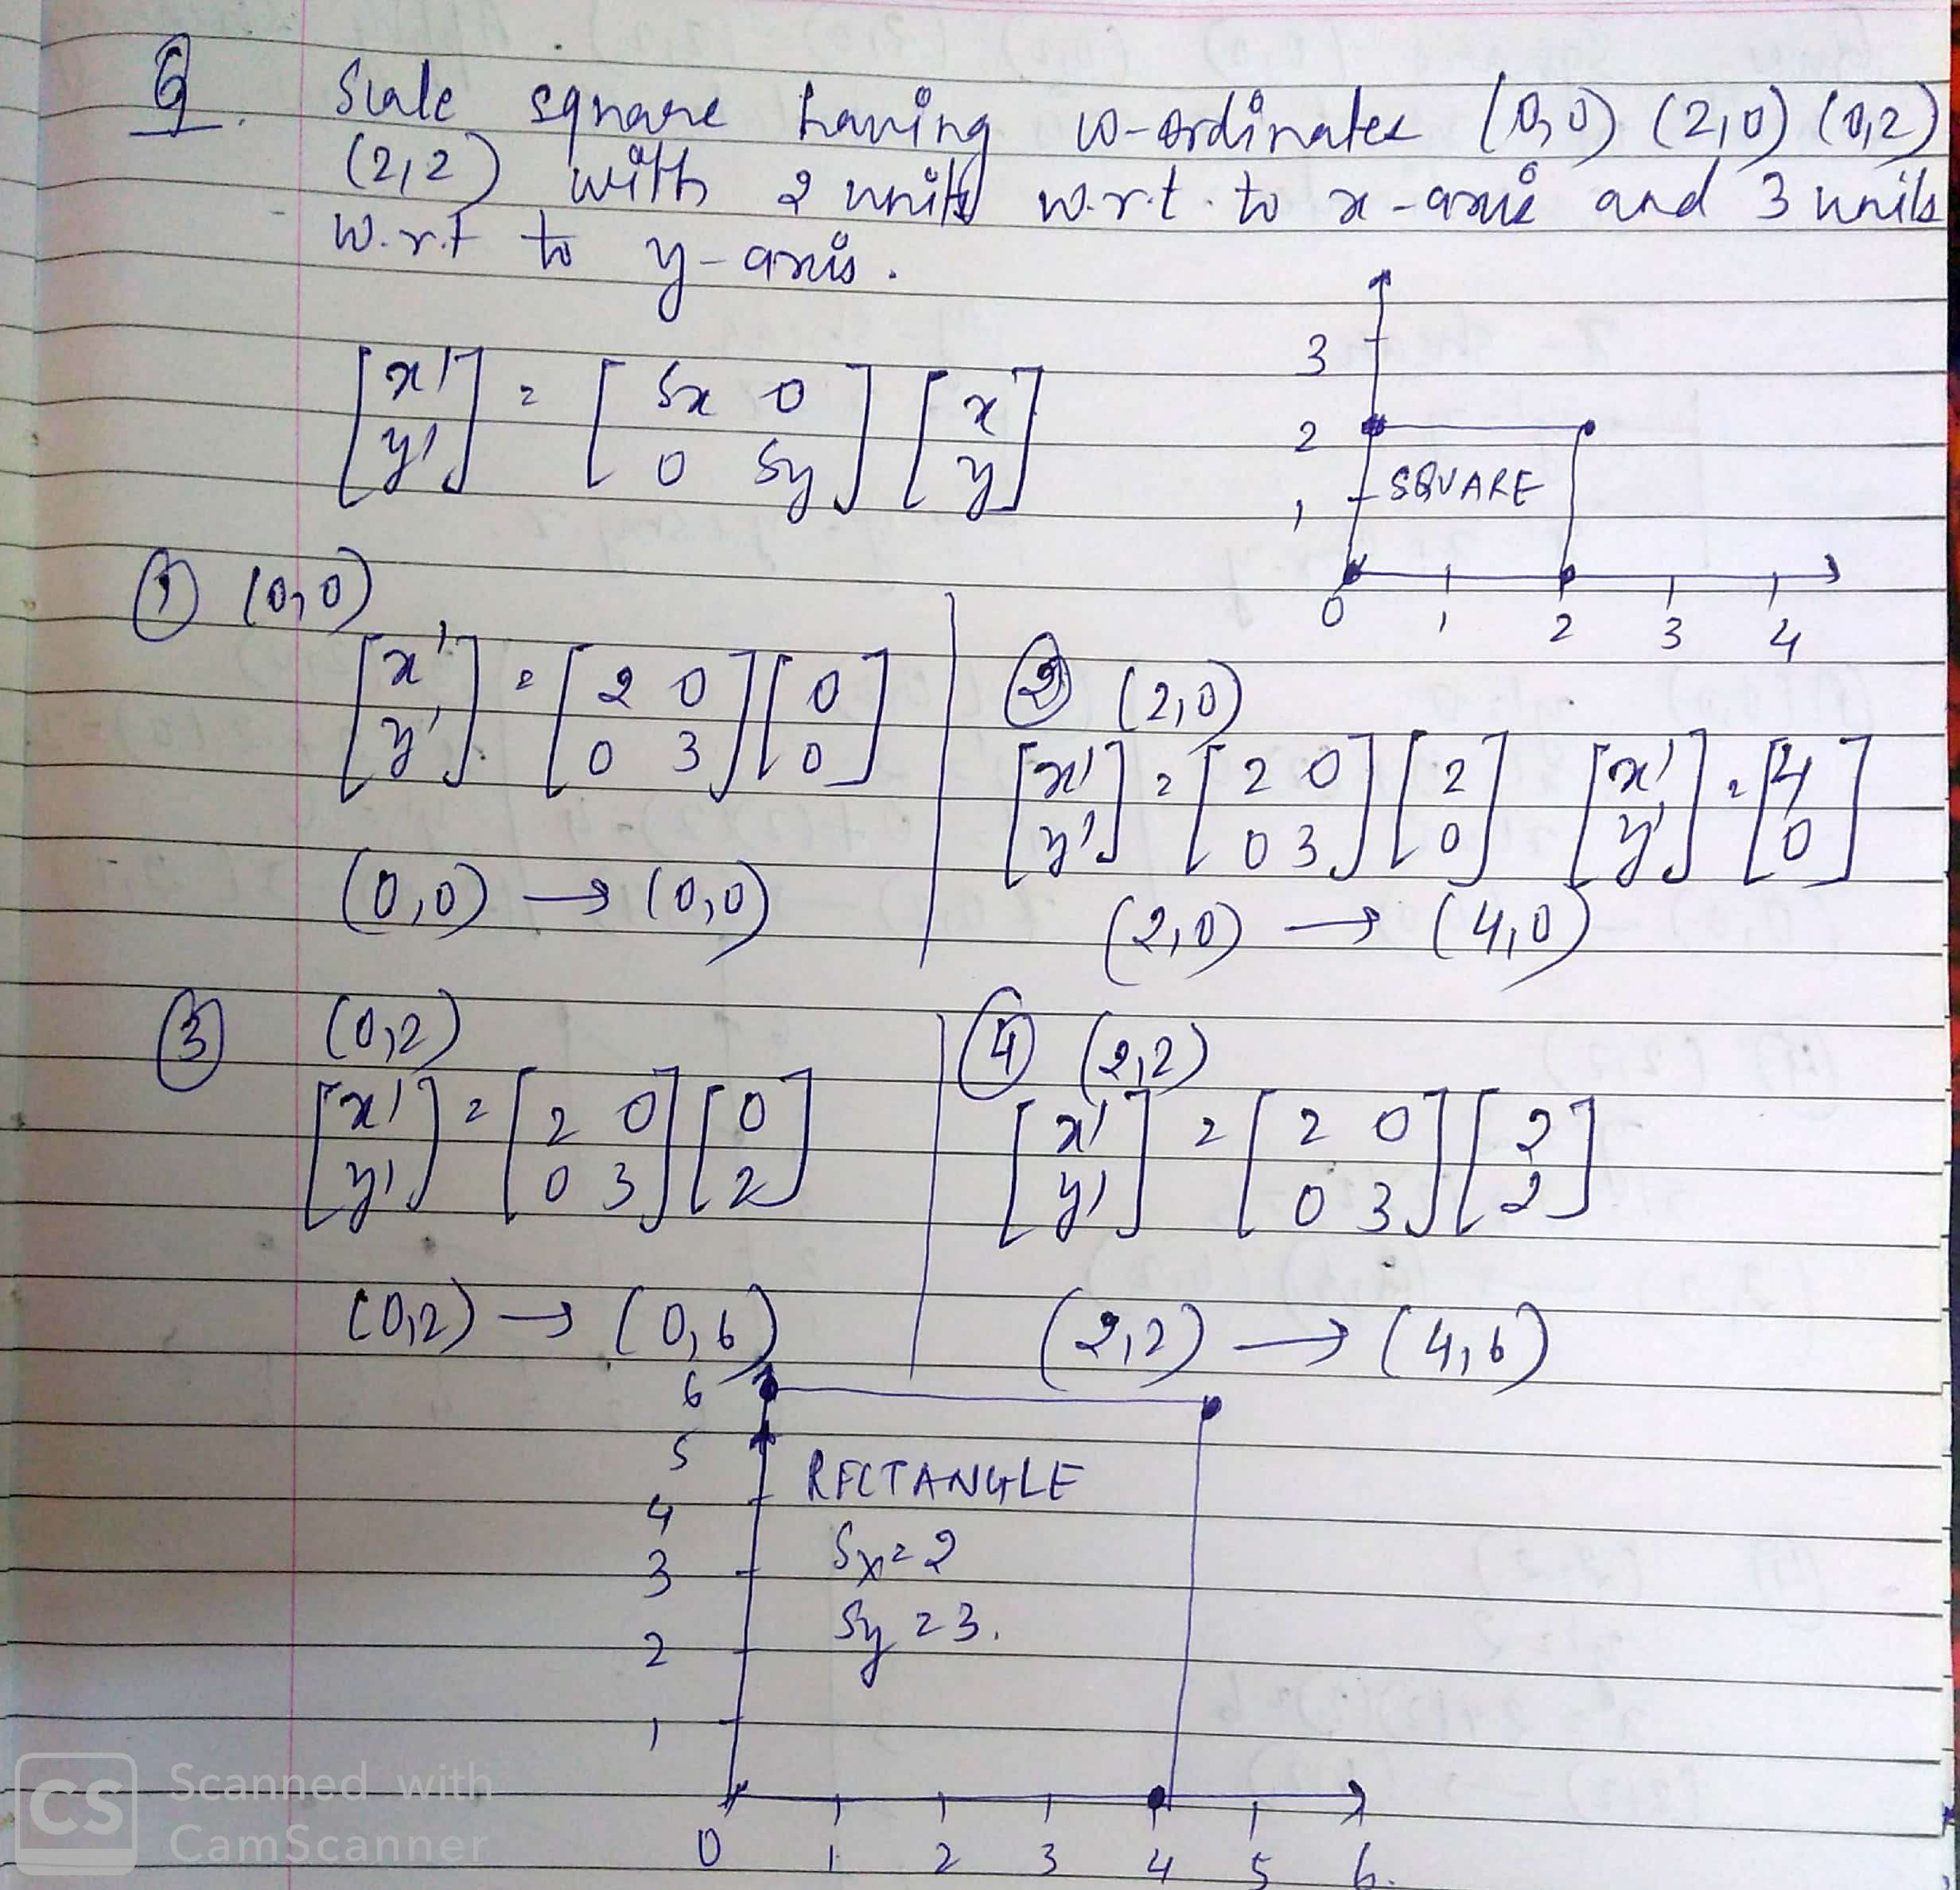

Slide 31
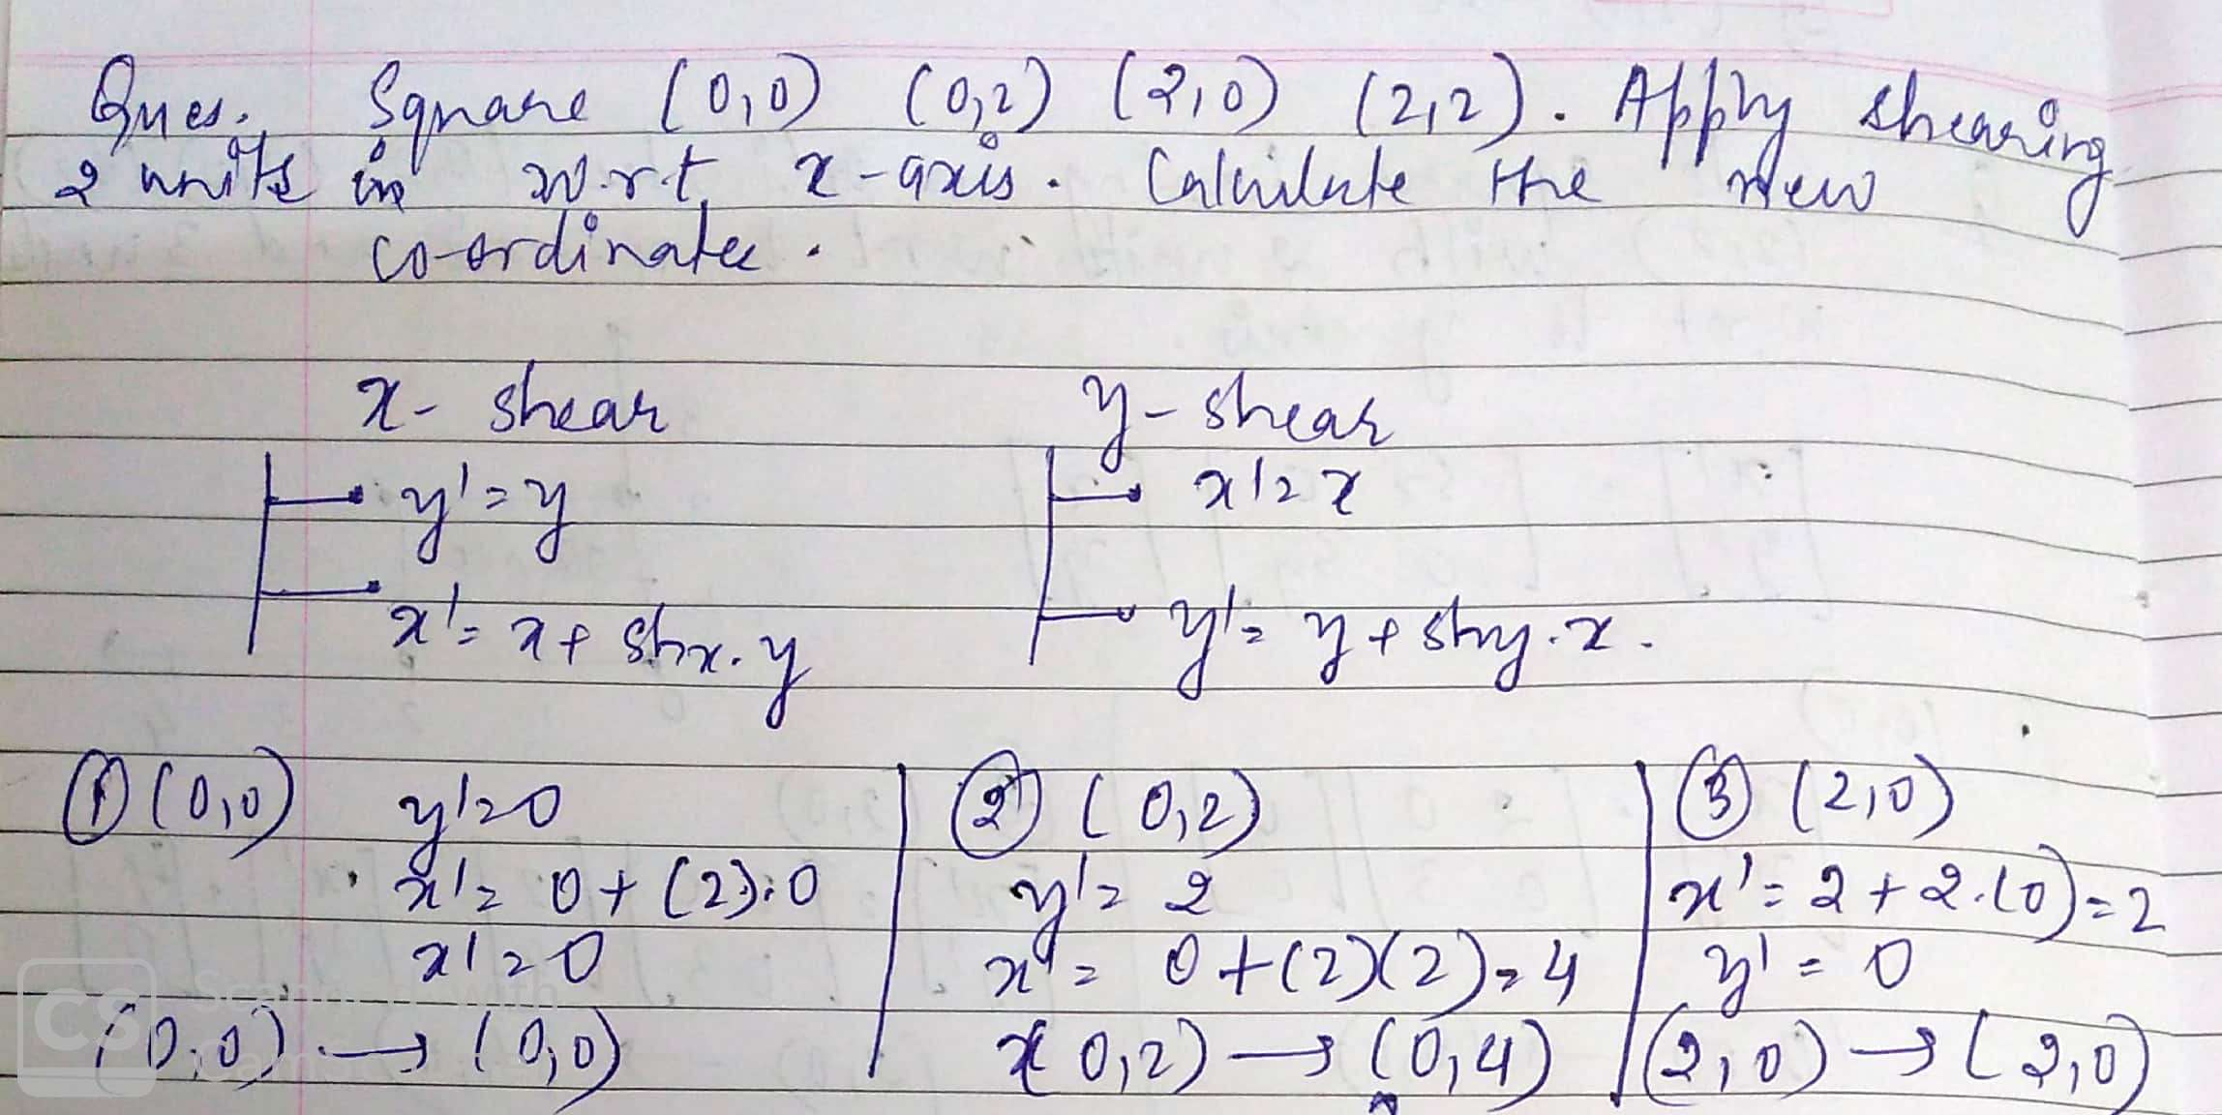

Slide 32
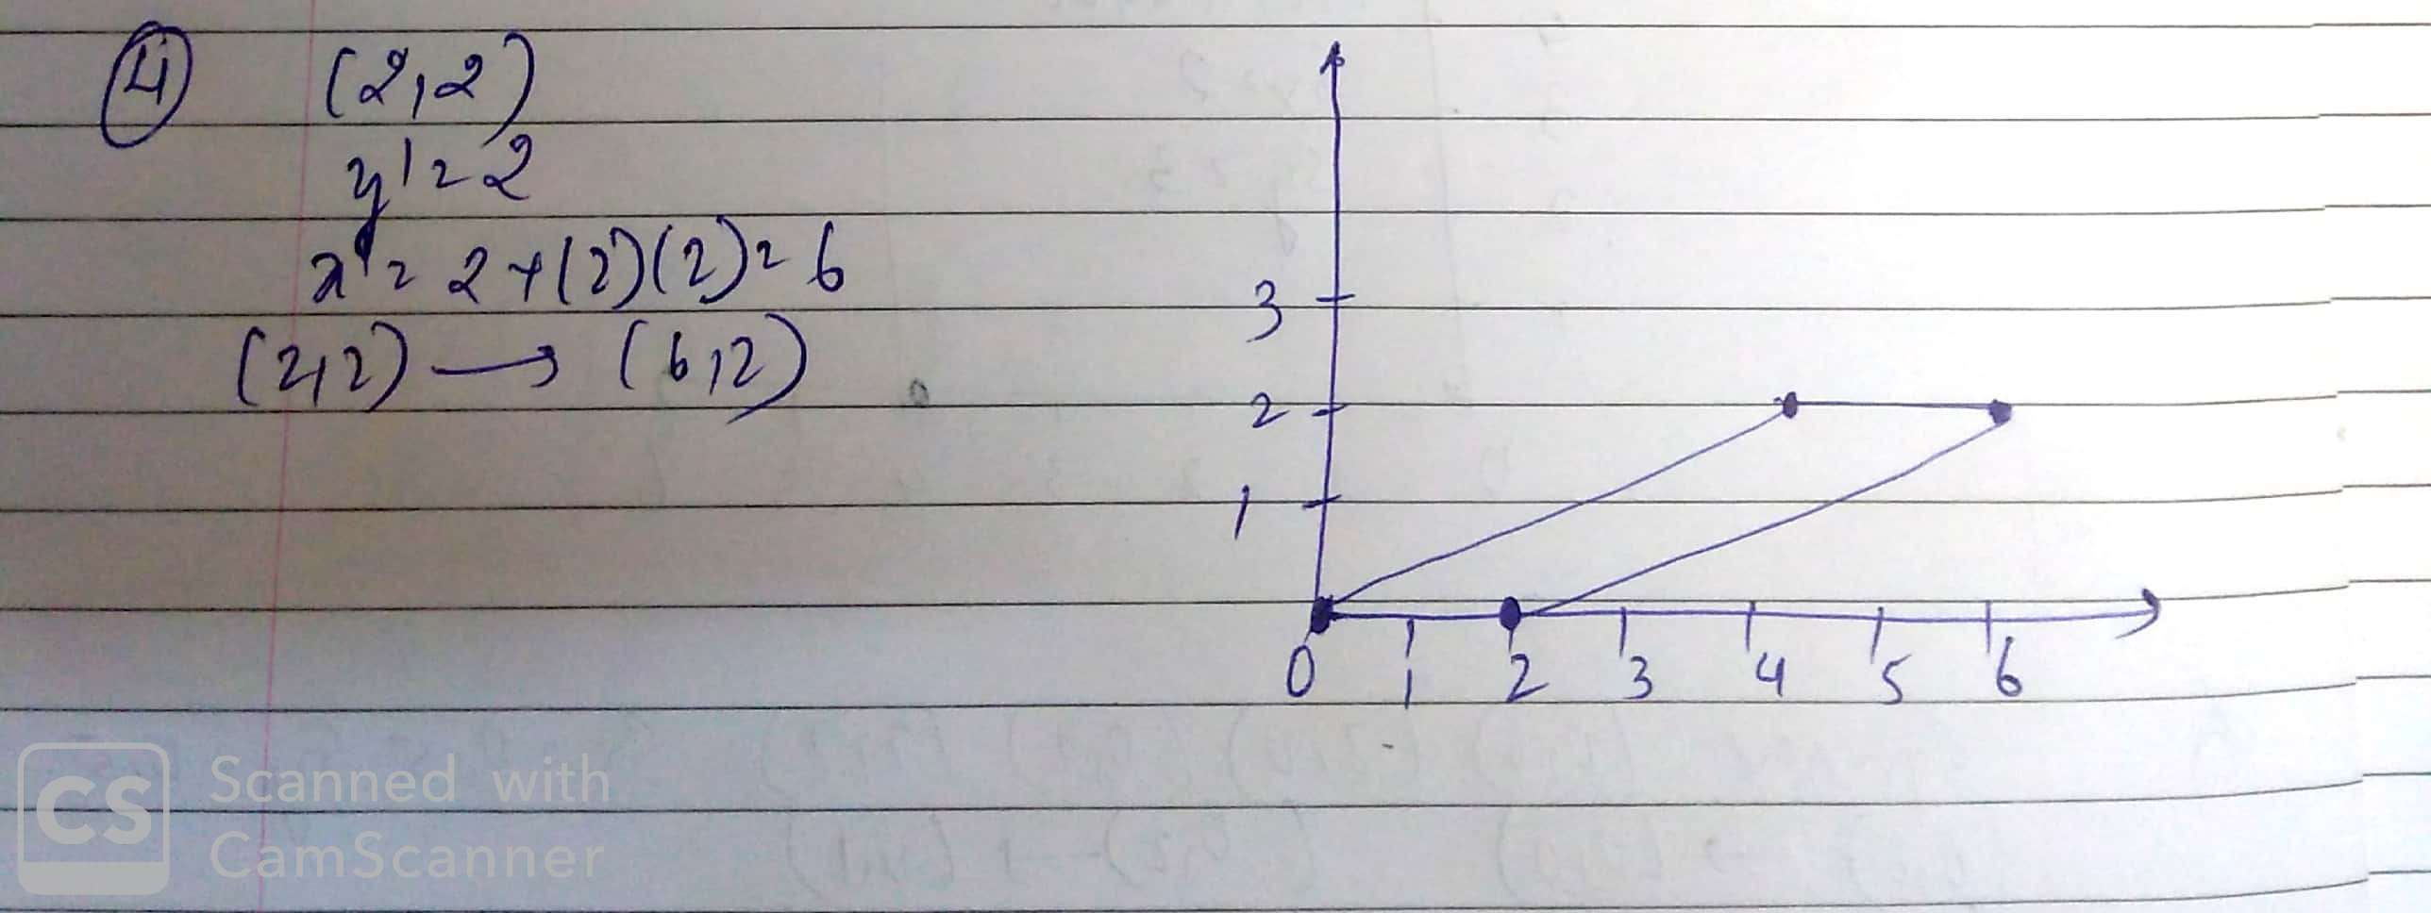

Slide 33
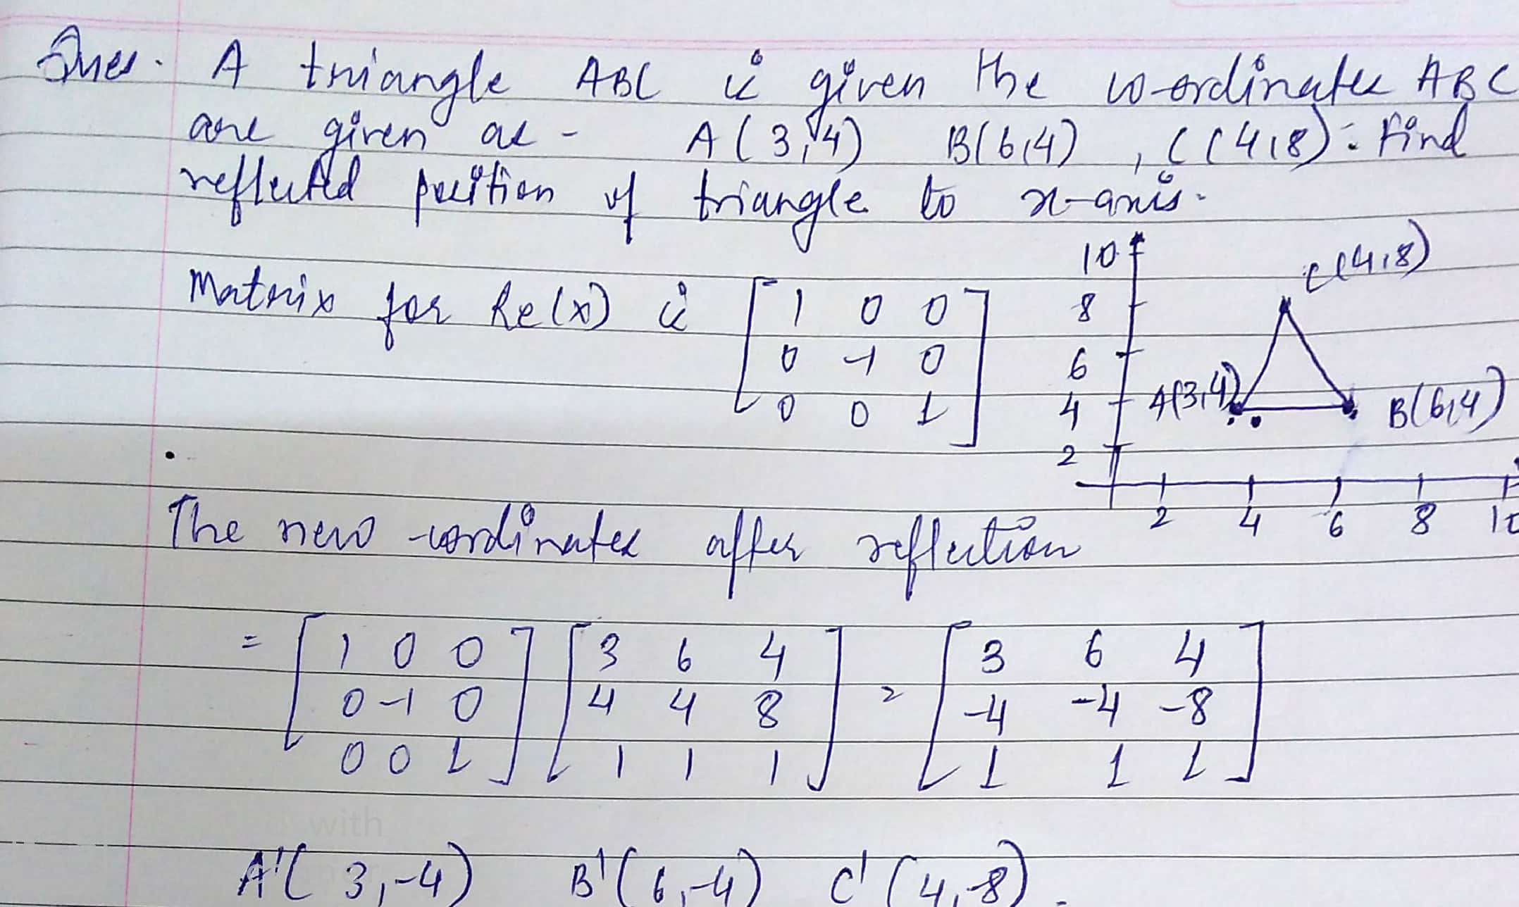

Slide 34
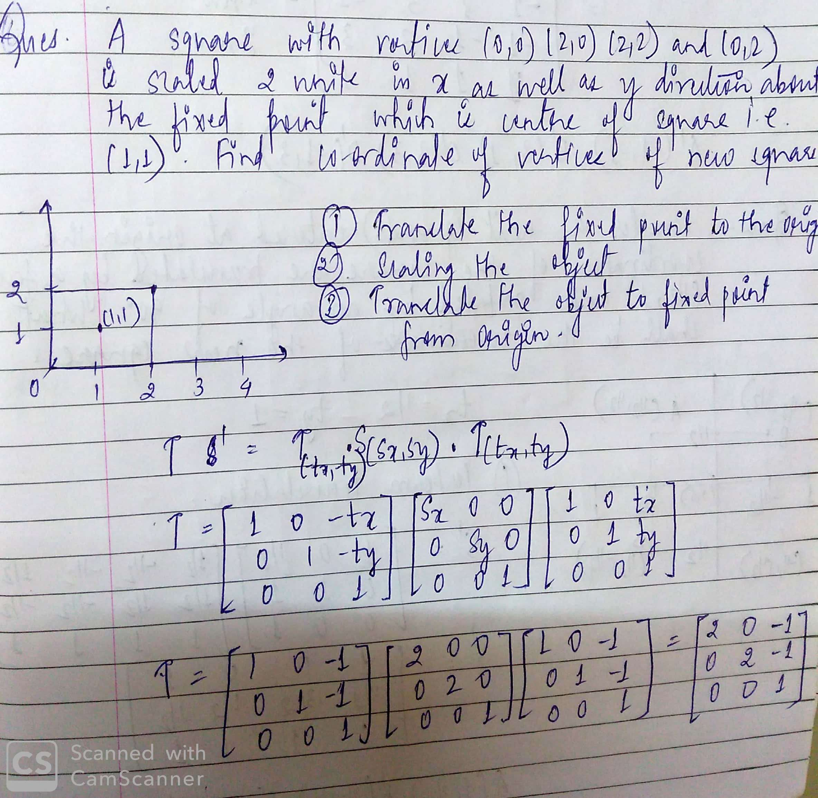

Slide 35
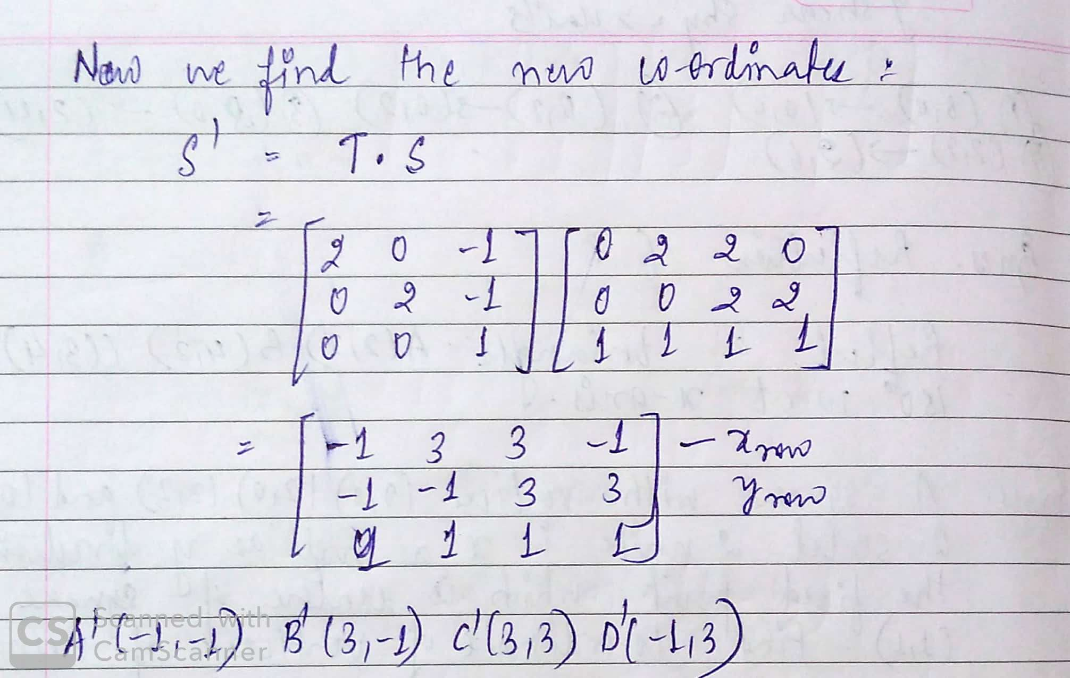

Slide 36
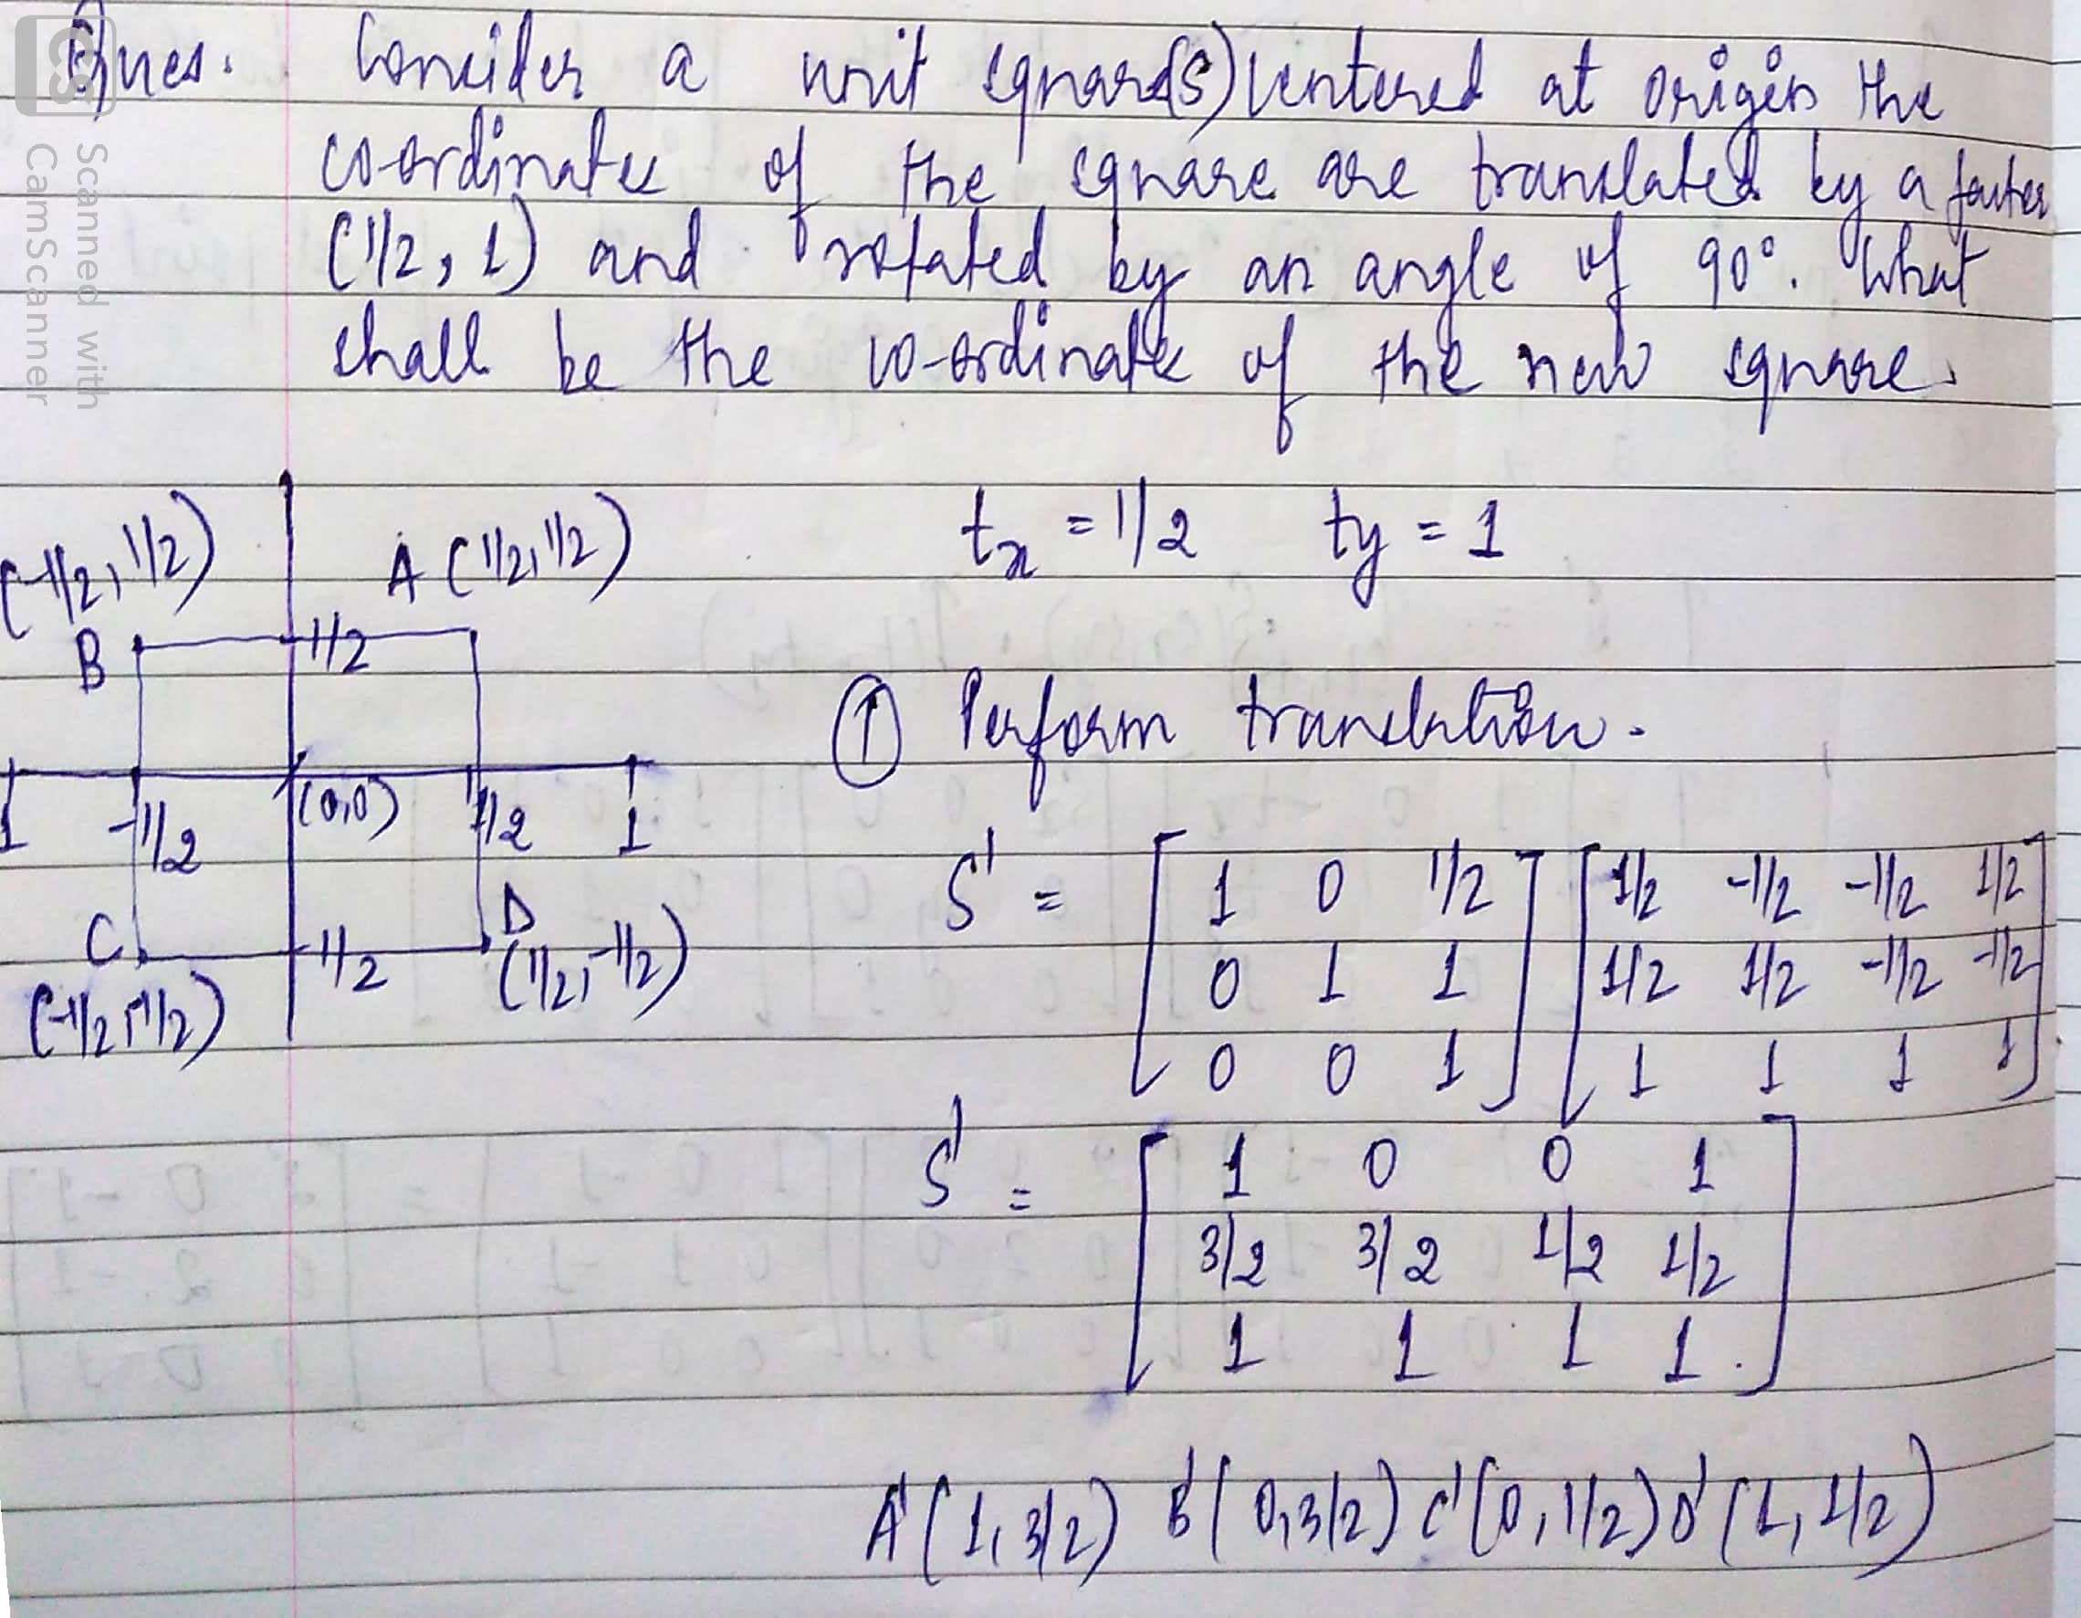

Slide 37
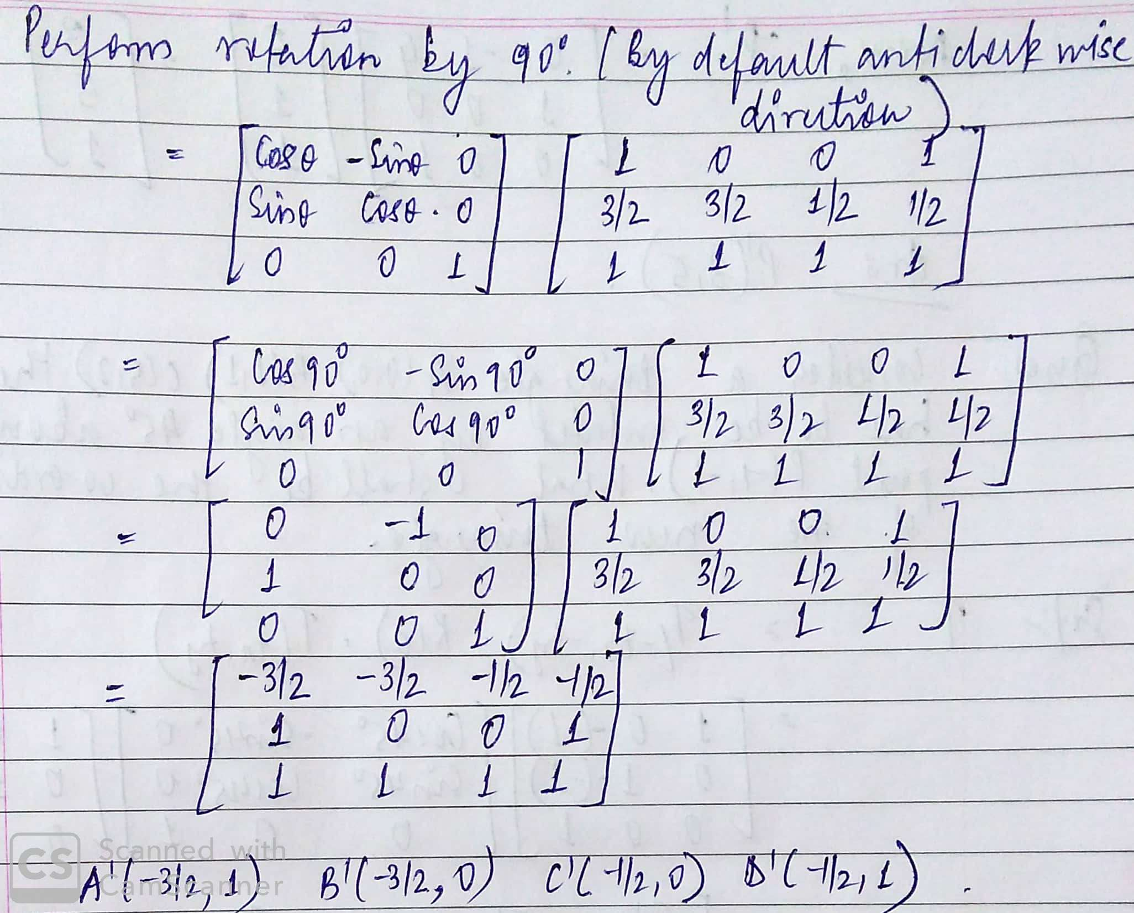

Slide 38
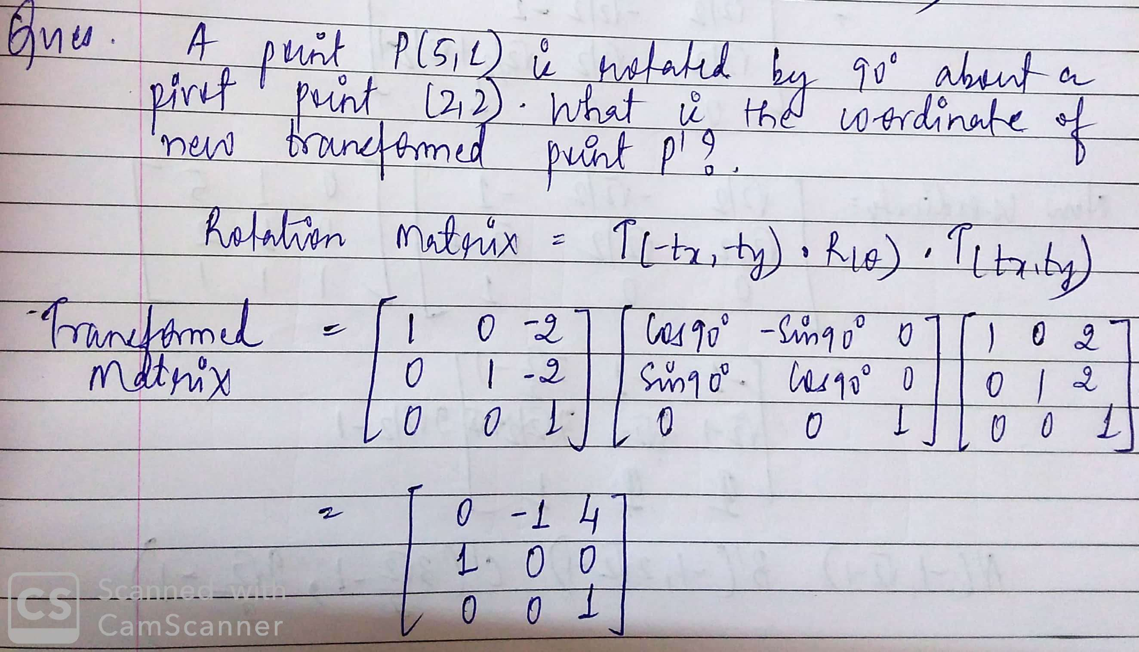

Slide 39
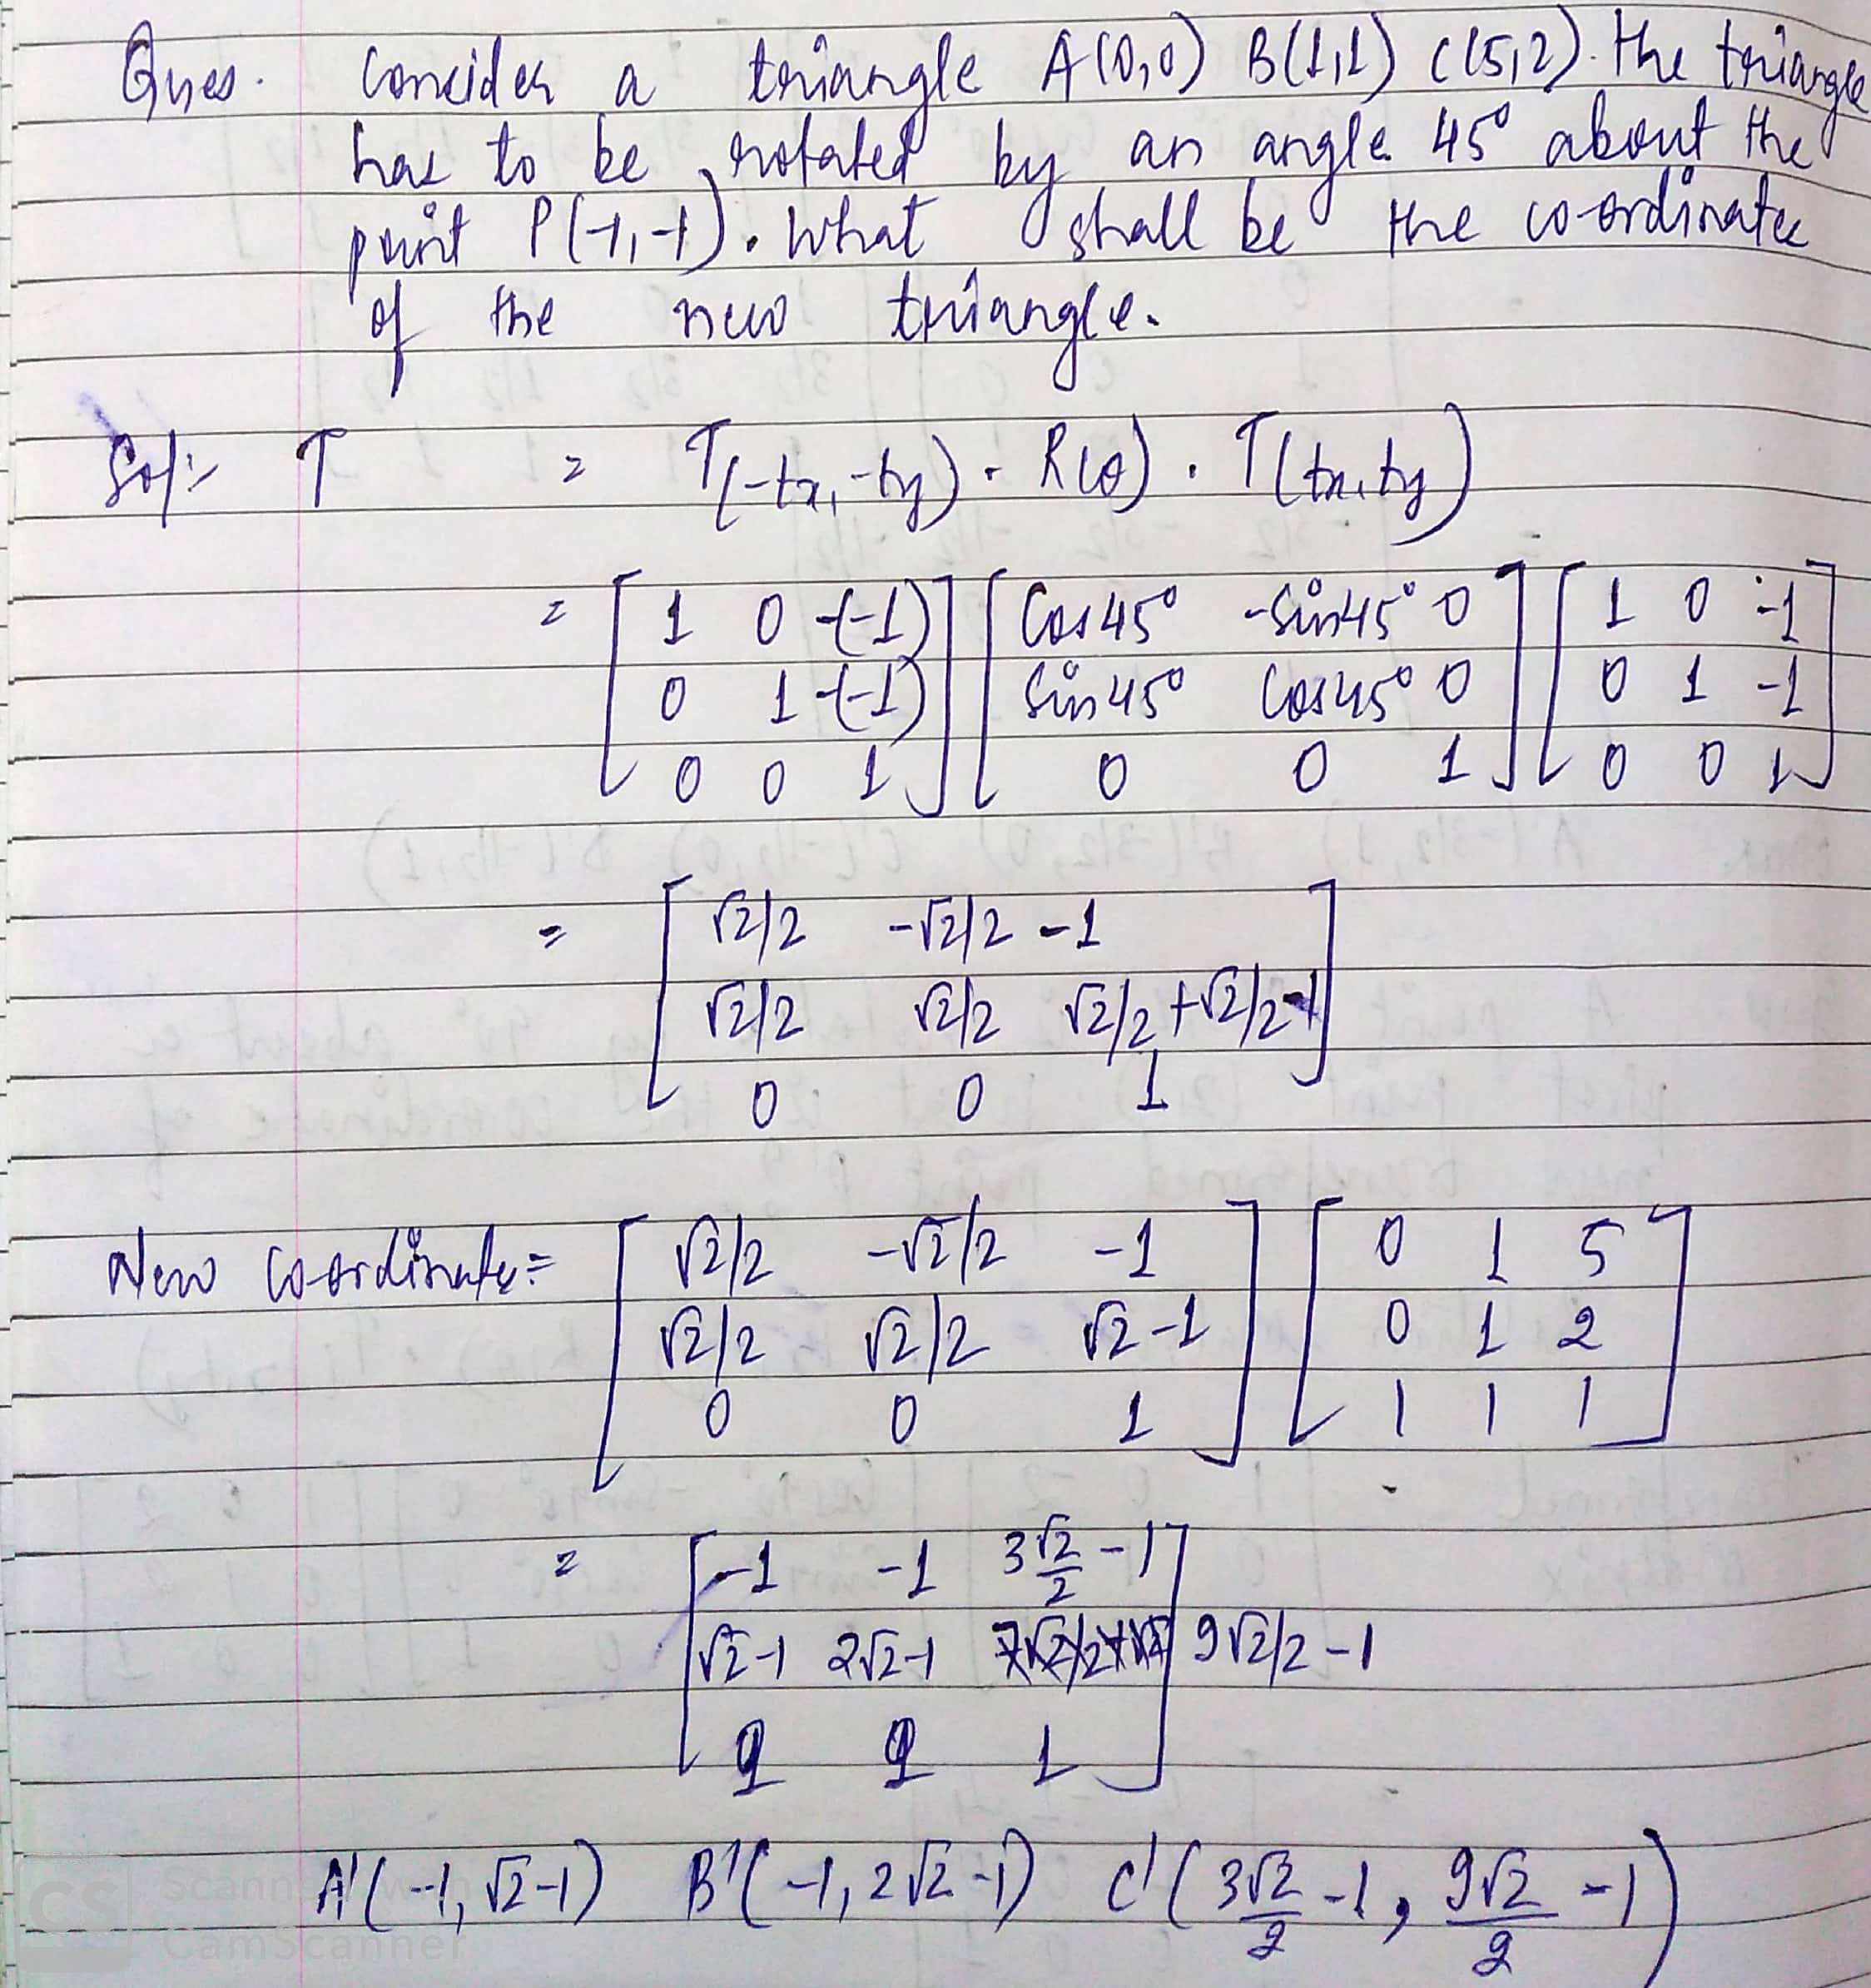

Slide 40
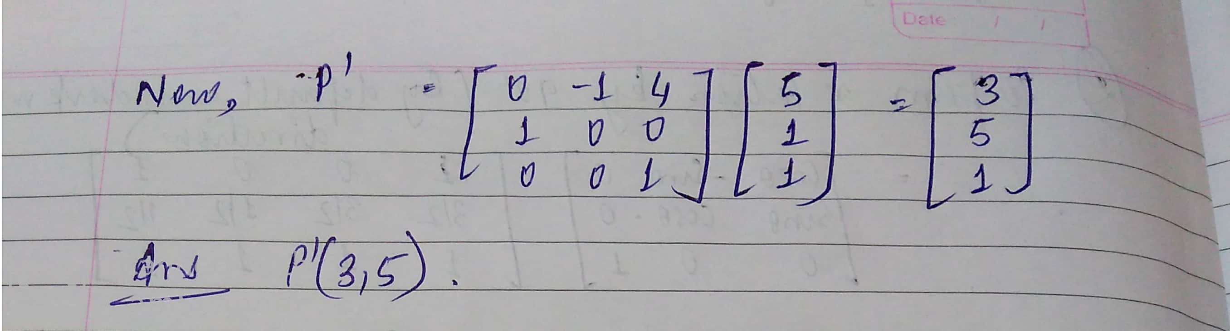

Slide 41
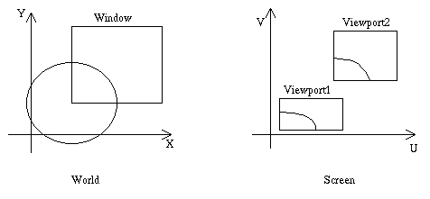
Y
Window
V
Viewport2
Viewport1
X
U
World
Screen

Slide 42
WINDOW TO VIEWPORT TRANSFORMATION
Purpose is to find the transformation matrix that maps the window in world coordinates to the viewport in screen coordinates.
Window:
(x, y space) denoted by: ^{x}min^{, y}min^{, x}max^{, y}max
Viewport: (u, v space) denoted by: ^{u}min^{, v}min^{, u}max^{, v}max

Slide 43
The overall transformation:
Translate the window to the origin
Scale it to the size of the viewport
Translate it to the viewport location
M_{WV} = T(U_{min},V_{min})* S(S_{x} , S_{y} )*T(−x_{min},− y_{min}); S_{x} = (U_{max} −U_{min})/(x_{max} − x_{min});
S_{y} = (V_{max} −V_{min})/( y_{max} − y_{min});
⎡S_{x} 0
M = ⎢ 0 S_{y}
⎢⎣ 0 0
(−x_{min} * S_{x} +U_{min})⎤
⎢
⎥
⎥
⎥⎦
(− y * S +V )
WV
min y min
1

Slide 44

Window – Viewport Transformation
Y
Y
^{(X}max^{, Y}max⁾
^{(X}min^{, Y}min⁾
Window in World Coordinates
V
X
X
Window translated to origin
Maximum Screen Coordinates
^{(U}min^{, V}min⁾
U
Viewport Translated to final position
V
U
Window Scaled to size to Viewport

Slide 45
Exercise -Transformations of Parallel Lines
Consider two parallel lines:
A[X₁, Y₁] to B[X₂, Y₂] and
C[X₃, Y₃] to B[X₄, Y₄].
Slope of the lines:
_{m =} Y₂ − Y₁
₌ Y₄ − Y₃
X ₂ − X₁
X ₄ − X ₃
Solve the problem:
If the lines are transformed by a matrix:
b⎤
⎢ ⎥
T = ^{⎡a}
⎣c d ⎦
The slope of the transformed lines is:
_{m' =} b + dm
a + cm

